Slide 1

18CSE345T-INTERNET OF THINGS ARCHITECTURE AND PROTOCOLS UNIT -I
M2M and IoT- Relevance and Transition- Building an architecture- Main design principles and needed capabilities- IoT architecture outline- M2M and IoT Technology Fundamentals- Devices and Gateways-Introduction- Basic Devices- Gateways- Advanced devices- Need for networking- State of the art-ETSI M2M- IoT Reference model: IoT Domain model- Information model- Functional model-Communication model -Safety, privacy, trust, security model- Introduction to Protocols- Physical, Data Link- Introduction to Protocols- Network, Transport, Application.

Slide 2
18CSE345T-INTERNET OF THINGS ARCHITECTURE AND PROTOCOLS
M2M and IoT- Relevance and Transition:
A Market Perspective
The increasing interest in M2M and IoT solutions has been driven by the potential large market and growth opportunities.
In M2M and IoT, the technology used for these solutions may be very similar, even use the same base components but the data is managed will be different.
In an M2M solution, data remains within strict boundaries, it is used solely for the purpose. In IoT, data may be used and reused for many different purposes.
Data can be shared between companies and value chains in internal information marketplaces.
Data could be publicly exchanged on a public information marketplace.
These marketplaces are based on the exchange of data in order to create information products.
Definition of M2M
Machine to machine refers to technology that allowed both wireless and wired systems to communicate with other devices of the same type.

Slide 3
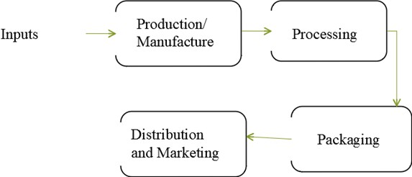
18CSE345T-INTERNET OF THINGS ARCHITECTURE AND PROTOCOLS
Global value chains
A value chain describes the full range of activities that firms and workers perform to bring a product from its conception to end use and beyond, including design, production, marketing, distribution, and support to the final consumer. Analyzing an industry from a global value chain (GVC) perspective permit understanding of the context of globalization on the activities contained within them by “focusing on the sequences of tangible and intangible value-adding activities, from conception and production to end use. GVC analysis therefore provides a holistic view of global industries both from the top down and from the bottom up”.M2M value chain

Slide 4
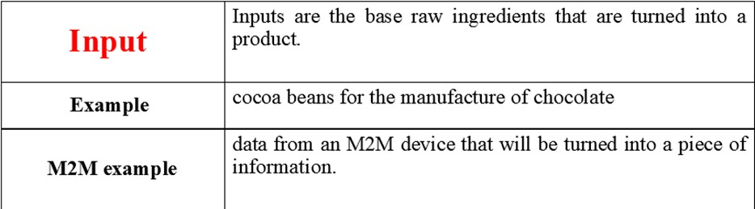
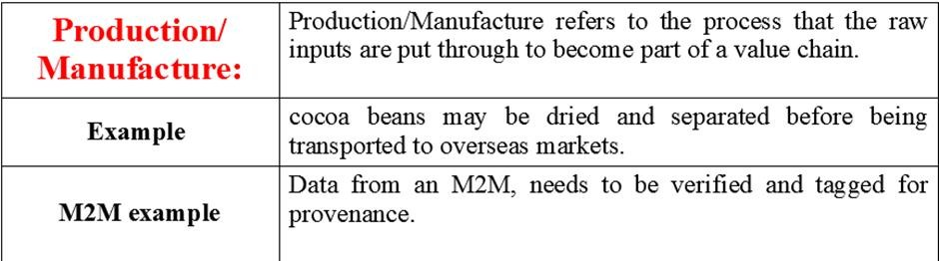
18CSE345T-INTERNET OF THINGS ARCHITECTURE AND PROTOCOLS

Slide 5
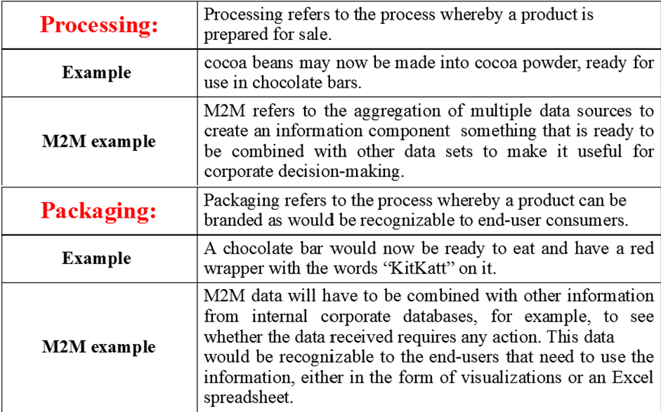
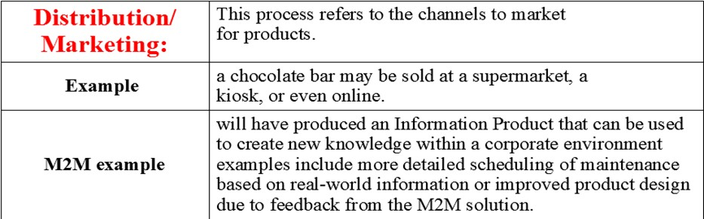
18CSE345T-INTERNET OF THINGS ARCHITECTURE AND PROTOCOLS

Slide 6
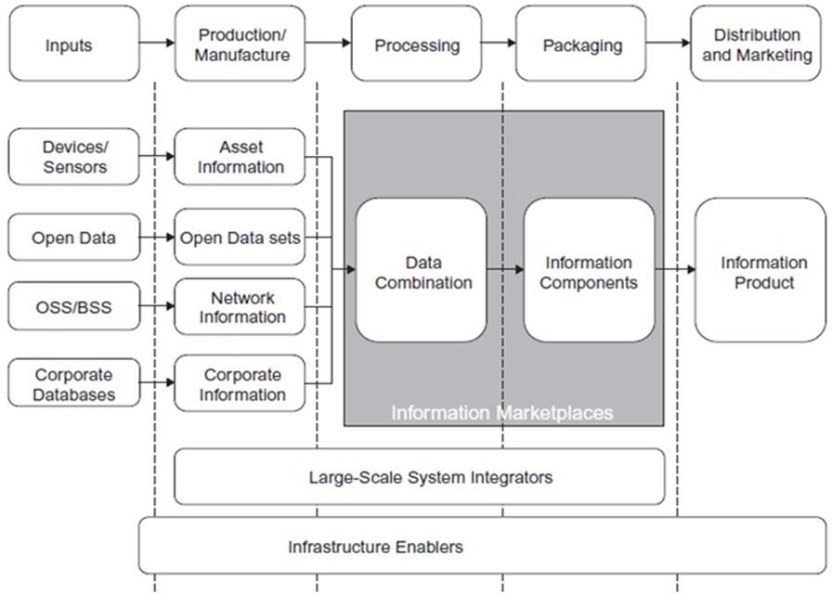
18CSE345T-INTERNET OF THINGS ARCHITECTURE AND PROTOCOLS
IoT value chains

Slide 7
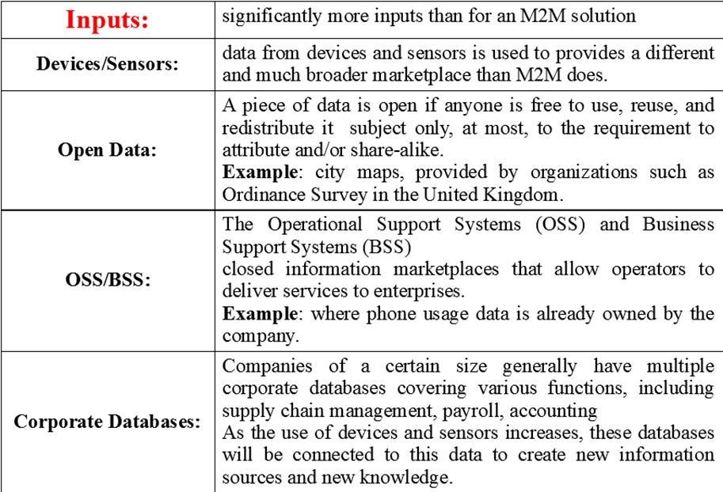
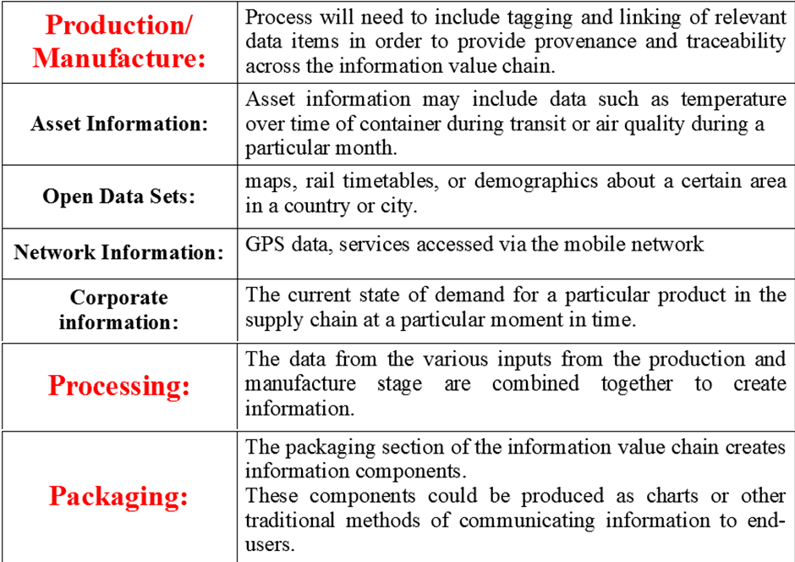

Slide 8
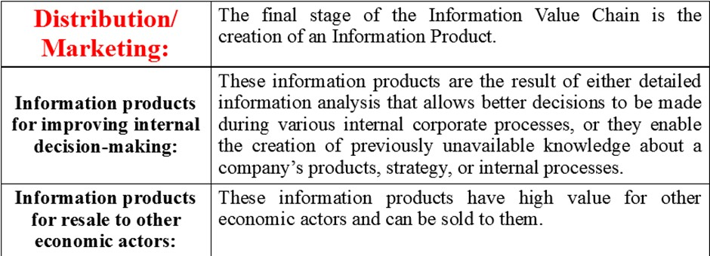
18CSE345T-INTERNET OF THINGS ARCHITECTURE AND PROTOCOLS

Slide 9
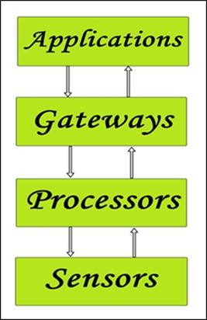
18CSE345T-INTERNET OF THINGS ARCHITECTURE AND PROTOCOLS
Building an architecture:
Four things form basic building blocks of the IoT system –sensors, processors, gateways, applications. Each of these nodes has to have its own characteristics in order to form a useful IoT system.
These form the front end of the IoT devices. These are the so-called “Things” of the system. Their main purpose is to collect data from its surroundings (sensors) or give out data to its surrounding (actuators). These have to be uniquely identifiable devices with a unique IP address so that they can be easily identifiable over a large network. These have to be active in nature which means that they should be able to collect real-time data. These can either work on their own (autonomous in nature) or can be made to work by the user depending on their needs (user-controlled).
Examples of sensors are gas sensor, water quality sensor, moisture sensor, etc.

Slide 10
18CSE345T-INTERNET OF THINGS ARCHITECTURE AND PROTOCOLS
Processors:
Processors are the brain of the IoT system. Their main function is to process the data captured by the sensors and process them so as to extract the valuable data from the enormous amount of raw data collected. In a word, we can say that it gives intelligence to the data. Processors mostly work on real-time basis and can be easily controlled by applications. These are also responsible for securing the data – that is performing encryption and decryption of data. Embedded hardware devices, microcontroller, etc are the ones that process the data because they have processors attached to it.
Gateways:
Gateways are responsible for routing the processed data and send it to proper locations for its (data) proper utilization. In other words, we can say that gateway helps in to and fro communication of the data. It provides network connectivity to the data. Network connectivity is essential for any IoT system to communicate.
LAN, WAN, PAN, etc are examples of network gateways. Applications:
Applications form another end of an IoT system. Applications are essential for proper utilization of all the data collected. These cloud-based applications which are responsible for rendering the effective meaning to the data collected. Applications are controlled by users and are a delivery point of particular services. Examples of applications are home automation apps, security systems, industrial control hub, etc.

Slide 11
18CSE345T-INTERNET OF THINGS ARCHITECTURE AND PROTOCOLS
Main design principles and needed capabilities-
1. Do your research
When designing IoT-enabled products, designers might make the mistake of forgetting why customers value these products in the first place. That’s why it’s a good idea to think about the value an IoT offering should deliver at the initial phase of your design. When getting into IoT design, you’re not building products anymore. You’re building services and experiences that improve people’s lives. That’s why in-depth qualitative research is the key to figuring out how you can do that. Assume the perspective of your customers to understand what they need and how your IoT implementation can solve their pain points. Research your target audience deeply to see what their existing experiences are and what they wish was different about them.
2. Concentrate on value
Early adopters are eager to try out new technologies. But the rest of your customer base might be reluctant to put a new solution to use. They may not feel confident with it and are likely to be cautious about using it. If you want your IoT solution to become widely adopted, you need to focus on the actual tangible value it’s going to deliver to your target audience. What is the real end-user value of your solution? What might be the barriers to adopting new technology? How can your solution address them specifically? Note that the features the early tech adopters might find valuable might turn out to be completely uninteresting for the majority of users. That’s why you need to carefully plan which features to include and in what order, always concentrating on the actual value they provide.

Slide 12
18CSE345T-INTERNET OF THINGS ARCHITECTURE AND PROTOCOLS
3. Don’t forget about the bigger picture:
One characteristic trait of IoT solutions is that they typically include multiple devices that come with different capabilities and consist of both digital and physical touchpoints. Your solution might also be delivered to users in cooperation with service providers. That’s why it’s not enough to design a single touchpoint well. Instead, you need to take the bigger picture into account and treat your IoT system holistically. Delineate the role of every device and service. Develop a conceptual model of how users will perceive and understand the system. All the parts of your system need to work seamlessly together. Only then you’ll be able to create a meaningful experience for your end-users.
4. Remember about the security:
Don’t forget that IoT solutions aren’t purely digital. They’re located in the real-world context, and the consequences of their actions might be serious if something goes wrong. At the same time, building trust in IoT solutions should be one of your main design drivers. Make sure that every interaction with your product builds consumer trust rather than breaking it. In practice, it means that you should understand all the possible error situations that may be related to the context of its use. Then try to design your product in a way to prevent them. If error situations occur, make sure that the user is informed appropriately and provided with help. Also, consider data security and privacy as a key aspect of your implementation. Users need to feel that their data is safe, and objects located in their workspaces or home can’t be hacked. That’s why quality assurance and testing the system in the real-world context are so important.

Slide 13
18CSE345T-INTERNET OF THINGS ARCHITECTURE AND PROTOCOLS
5. Build with the context in mind
And speaking of context, it pays to remember that IoT solutions are located at the intersection of the physical and digital world. The commands you give through digital interfaces produce real-world effects. Unlike digital commands, these actions may not be easily undone. In a real-world context, many unexpected things may happen. That’s why you need to make sure that the design of your solution enables users to feel safe and in control at all times. The context itself is a crucial consideration during IoT design. Depending on the physical context of your solution, you might have different goals in mind. For example, you might want to minimize user distraction or design devices that will be resistant to the changing weather conditions. The social context is an important factor, as well. Don’t forget that the devices you design for workspaces or homes will be used by multiple users.
6. Make good use of prototypes
IoT solutions are often difficult to upgrade. Once the user places the connected object somewhere, it might be hard to replace it with a new version – especially if the user would have to pay for the upgrade. Even the software within the object might be hard to update because of security and privacy reasons. Make sure that your design practices help to avoid costly hardware iterations. Get your solution right from the start. From the design perspective, it means that prototyping and rapid iteration will become critical in the early stages of the project.

Slide 14
18CSE345T-INTERNET OF THINGS ARCHITECTURE AND PROTOCOLS
M2M to IoT-An Architectural Overview IoT Architecture Overview
IoT can be classified into a four or five-layered architecture which gives you a complete overview of how it works in real life. The various components of the architecture include the following:
Four-layered architecture: this includes media/device layer, network layer, service and application support layer, and application layer.
Five-layered architecture: this includes perception layer, network layer, middleware layer, application layer, and business layer.
Functions of Each Layer
Sensor/Perception layer: This layer comprises of wireless devices, sensors, and radio frequency identification (RFID) tags that are used for collecting and transmitting raw data such as the temperature, moisture, etc. which is passed on to the next layer.
Network layer: This layer is largely responsible for routing data to the next layer in the hierarchy with the help of network protocols. It uses wired and wireless technologies for data transmission.
Middleware layer: This layer comprises of databases that store the information passed on by the lower layers where it performs information processing and uses the results to make further decisions.

Slide 15
18CSE345T-INTERNET OF THINGS ARCHITECTURE AND PROTOCOLS
Service and application support layer: This layer involve business process modeling and execution as well as IoT service monitoring and resolution.
Application layer: It consists of application user interface and deals with various applications such as home automation, electronic health monitoring, etc.
Business layer: this layer determines the future or further actions required based on the data provided by the lower layers.
M2M and IoT Technology Fundamentals- Devices and gateways
A device is a hardware unit that can sense aspects of it’s environment and/or actuate, i.e. perform tasks in its environment. A device can be characterized as having several properties, including:
Microcontroller: 8-, 16-, or 32-bit working memory and storage.
Power Source: Fixed, battery, energy harvesting, or hybrid.
Sensors and Actuators: Onboard sensors and actuators, or circuitry that allows them to be connected, sampled, conditioned, and controlled.
Communication: Cellular, wireless, or wired for LAN and WAN communication.
Operating System (OS): Main-loop, event-based, real-time, or full featured OS.
Applications: Simple sensor sampling or more advanced applications.

Slide 16
18CSE345T-INTERNET OF THINGS ARCHITECTURE AND PROTOCOLS
User Interface: Display, buttons, or other functions for user interaction.
Device Management (DM): Provisioning, firmware, bootstrapping, and monitoring.
Execution Environment (EE): Application lifecycle management and Application Programming Interface (API).
For several reasons, one or more of these functions are often hosted on a gateway instead. This can be to save battery power, for example, by letting the gateway handle heavy functions such as WAN connectivity and application logic that requires a powerful processor. This also leads to reduced costs because these are expensive components. Another reason is to reduce complexity by letting a central node (the (the gateway) handle functionality such as device management and advanced applications, while letting the devices focus on sensing and actuating.
Device types
There are no clear criteria today for categorizing devices, but instead there is more of a sliding scale. we group devices into two categories.
Basic Devices:
Devices that only provide the basic services of sensor readings and/or actuation tasks, and in some cases limited support for user interaction.
LAN communication is supported via wired or wireless technology, thus a gateway is needed to provide the WAN connection.

Slide 17
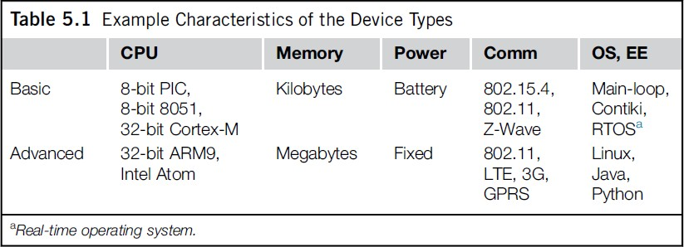
18CSE345T-INTERNET OF THINGS ARCHITECTURE AND PROTOCOLS
Advanced Devices:
In this case the devices also host the application logic and a WAN connection.
They may also feature device management and an execution environment for hosting multiple applications. Gateway devices are most likely to fall into this category.
Deployment scenarios for devices
Deployment can differ for basic and advanced deployment scenarios. Example deployment scenarios for basic devices include:
Home Alarms
Such devices typically include motion detectors, magnetic sensors, and smoke detectors.
A central unit takes care of the application logic that calls security and sounds an alarm if a sensor is activated when the alarm is armed. The central unit also handles the WAN connection towards the alarm central. These systems are currently often based on proprietary radio protocols.

Slide 18
18CSE345T-INTERNET OF THINGS ARCHITECTURE AND PROTOCOLS
Smart Meters
The meters are installed in the households and measure consumption of, for example, electricity and gas.A concentrator gateway collects data from the meters, performs aggregation, and periodically transmits the aggregated data to an application server over a cellular connection.
By using a capillary network technology e.g. 802.15.4), it’s possible to extend the range of the concentrator gateway by allowing meters in the periphery to use other meters as extenders, and interface with handheld devices on the Home Area Network side.
Building Automation Systems (BASs): Such devices include thermostats, fans, motion detectors, and boilers, which are controlled by local facilities, but can also be remotely operated.
Standalone Smart Thermostats: These use Wi-Fi to communicate with web services.
Examples for advanced devices, meanwhile, include:
Onboard units in cars that perform remote monitoring and configuration over a cellular connection.
Robots and autonomous vehicles such as unmanned aerial vehicles that can work both autonomously or by remote control using a cellular connection.
Video cameras for remote monitoring over 3G and LTE.
Oil well monitoring and collection of data points from remote devices.
Connected printers that can be upgraded and serviced remotely. The devices and gateways of today often use legacy technologies such as KNX, Z- Wave, and ZigBee

Slide 19
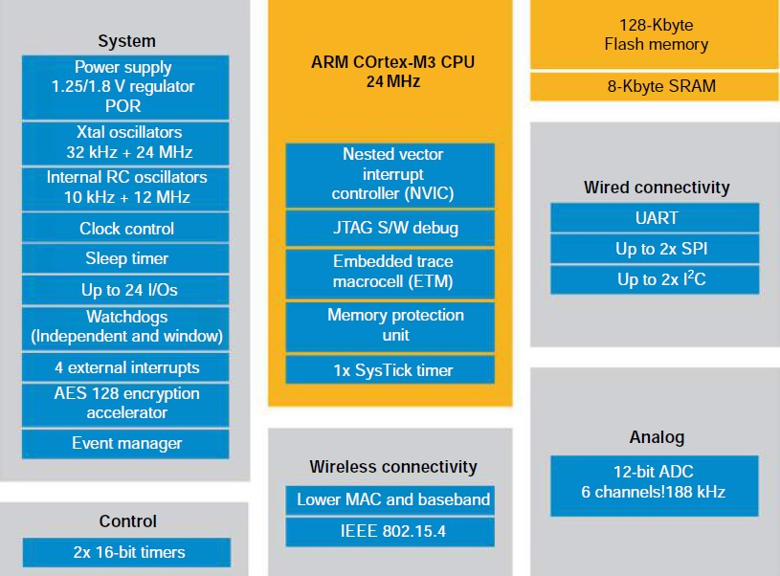
18CSE345T-INTERNET OF THINGS ARCHITECTURE AND PROTOCOLS
Basic devices
These devices are often intended for a single purpose, such as measuring air pressure or closing a valve. In some cases, several functions are deployed on the same device, such as monitoring humidity, temperature, and light level.
The requirements on hardware are low, both in terms of processing power and memory.
The focus is on keeping the bill of materials (BOM) as low as possible by using inexpensive microcontrollers with built-in memory and storage, often on an SoC- integrated circuit with all main components on one single chip.
Another common goal is to enable battery as a power source, with a lifespan of a year and upwards by using ultra-low energy microcontrollers.

Slide 20
18CSE345T-INTERNET OF THINGS ARCHITECTURE AND PROTOCOLS
The microcontroller typically hosts a few ports that allow integration with sensors and actuators, such as General Purpose I/O (GPIO) and an analog-to-digital converter (ADC) for supporting analog input.
For certain actuators, such as motors, pulse-width modulation (PWM) can be used.
As low-power operation is paramount to battery-powered devices, the microcontroller hosts functions that facilitate sleeping, such as interrupts that can wake up the device on external and internal events, e.g. when there is activity on a GPIO port or the radio, as well as timer-based wake ups.
Some devices even go as far as harvesting energy from their environment, e.g. in the form of solar, thermal, and physical energy.
To interact with peripherals such as storage or display, it’s common to use a serial interface such as SPI, I2C, or UART.
These interfaces can also be used to communicate with another microcontroller on the device.
This is common when the there is a need for offloading certain tasks, or when in some cases the entire application logic is put on a separate host processor.
It’s not unusual for the microcontroller to also contain a security processor, e.g. to accelerate Advanced Encryption Standard (AES). This is necessary to allow encrypted communication over the radio link without the need for a host processor.

Slide 21
18CSE345T-INTERNET OF THINGS ARCHITECTURE AND PROTOCOLS
Because a basic device lacks a WAN interface according to our definition, a gateway of some form is necessary. The gateway together with the connected devices form a capillary network.
The microcontroller contains most of the radio functions needed for communicating with the gateway and other devices in the same capillary network.
An external antenna is, however, necessary, and preferably a filter that removes unwanted frequencies, e.g. a surface acoustic wave (SAW) filter.
Due to limited computational resources, these devices commonly do not use a typical OS. It may be something as simple as a single-threaded main-loop or a low-end OS such as Free RTOS, Atom threads, AVIX-RT, Chibi OS/RT, ERIKA Enterprise, Tiny OS, or Thing square Mist/Contiki.
These OSes offer basic functionality, e.g., memory and concurrency model management, (sensor and radio) drivers, threading, TCP/IP, and higher level protocol stacks.
A typical task for the application logic is to read values from the sensors and to provide these over the LAN interface in a semantically correct manner with the correct units.
For this class of devices, the constrained hardware and non-standard software limit third-party development and make development quite cost intensive.

Slide 22
18CSE345T-INTERNET OF THINGS ARCHITECTURE AND PROTOCOLS
Gateways
A gateway serves as a translator between different protocols, e.g. Between IEEE 802.15.4 or IEEE 802.11, to Ethernet or cellular.
There are many different types of gateways, which can work on different levels in the protocol layers. Most often a gateway refers to a device that performs translation of the physical and link layer, but application layer gateways (ALGs) are also common.
The latter is preferably avoided because it adds complexity and is a common source of error in deployments.
Some examples of ALGs include the ZigBee Gateway Device (ZigBee Alliance 2011), which translates from ZigBee to SOAP and IP, or gateways that translate from Constrained Application Protocol (CoAP) to Hyper Text Transfer Protocol/Representational State Transfer (HTTP/REST).
For some LAN technologies, such as 802.11 and Z-Wave, the gateway is used for inclusion and exclusion of devices.
This typically works by activating the gateway into inclusion or exclusion mode and by pressing a button on the device to be added or removed from the network.
For very basic gateways, the hardware is typically focused on simplicity and low cost, but frequently the gateway device is also used for many other tasks, such as data management, device management, and local applications.
In these cases, more powerful hardware with GNU/Linux is commonly used.

Slide 23
18CSE345T-INTERNET OF THINGS ARCHITECTURE AND PROTOCOLS
Advanced devices
As mentioned earlier, the distinction between basic devices, gateways, and advanced devices is not cut in stone, but some features that can characterize an advanced device are the following:
A powerful CPU or microcontroller with enough memory and storage to host advanced applications, such as a printer offering functions for copying, faxing, printing, and remote management.
A more advanced user interface with, for example, display and advanced user input in the form of a keypad or touch screen.
Video or other high bandwidth functions
It is not unusual for the advanced device to also function as a gateway for local devices on the same LAN.
By offering a more common and open OS, along with community standardized APIs, software libraries, programming languages, and development tools, the number of potential developers grows significantly.

Slide 24
18CSE345T-INTERNET OF THINGS ARCHITECTURE AND PROTOCOLS
NEED FOR NETWORKING:
Local and wide area networking
A network is created when two or more computing devices exchange data or information.
The ability to exchange pieces of information using telecommunications technologies has changed the world.
In modern computing, nodes range from personal computers, servers, and dedicated packet switching hardware, to smartphones, games consoles, television sets and, increasingly, heterogeneous devices that are generally characterized by limited resources and functionalities.
Limitations typically include computation, energy, memory, communication (range, bandwidth, reliability, etc.) and application specificity (e.g., specific sensors, actuators, tasks), etc. Such devices are typically dedicated to specific tasks, such as sensing, monitoring, and control
Network links rely upon a physical medium, such as electrical wires, air, and optical fibers, over which data can be sent from one network node to the next.
When direct communication between two nodes over a physical medium is not possible, networking can allow for these devices to communicate over a few hops.
Therefore, if node A wishes to transfer data to node C, it must do so through node B.

Slide 25

18CSE345T-INTERNET OF THINGS ARCHITECTURE AND PROTOCOLS
Communication between nodes A, B and C
Beyond the basic ability to transfer data, the speed and accuracy with which data can be transferred is of critical importance to the application.
A Local Area Network (LAN) was traditionally distinguishable from a Wide Area Network (WAN) based on the geographic coverage requirements of the network, and the need for third party, or leased, communication infrastructure.
In the case of the LAN, a smaller geographic region is covered, such as a commercial building, an office block, or a home, and does not require any leased communications infrastructure.
WANs provide communication links that cover longer distances, such as across metropolitan, regional, or by textbook definition, global geographic areas.
In practice, WANs are often used to link LANs and Metropolitan Area Networks (MAN)
Quantitatively, LANs tended to cover distances of tens to hundreds of meters, whereas WAN links spanned tens to hundreds of kilometers.

Slide 26
18CSE345T-INTERNET OF THINGS ARCHITECTURE AND PROTOCOLS
The most popular wired LAN technology is Ethernet. Wi-Fi is the most prevalent wireless LAN (WLAN) technology.
The current generation of WWAN technology includes LTE (or 4G) and WiMAX.
A more intuitive example of a similar device is the wireless access point commonly found in homes and offices.
In the home, the “wireless router” typically behaves as a link between the Wi-Fi (WLAN, and thus connected laptops, tablets, smartphones, etc. commonly found in the home) and Digital Subscriber Line (DSL) broadband connectivity, traditionally arriving over telephone lines.
“DSL” refers to Internet access carried over legacy (wired) telephone networks, and encompasses numerous standards and variants.
“Broadband” indicates the ability to carry multiple signals over a number of frequencies, with a typical minimum bandwidth of 256 kbps.
In the office, the Wi-Fi wireless access points are typically connected to the wired corporate (Ethernet) LAN, which is subsequently connected to a wider area network and Internet backbone, typically provided by an Internet Service Provider (ISP).

Slide 27
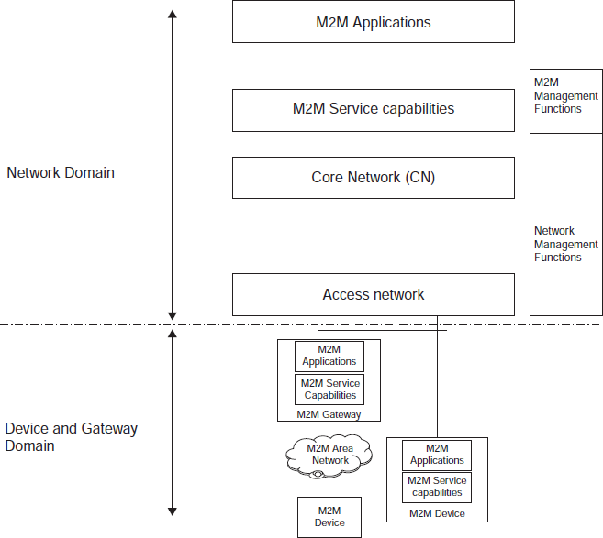
18CSE345T-INTERNET OF THINGS ARCHITECTURE AND PROTOCOLS
STATE OF AN ART-ETSI M2M:
WANs are typically required to bridge the M2M Device Domain to the backhaul network, thus providing a proxy that allows information (data, commands, etc.) to traverse heterogeneous networks.
Thus, the WAN can provide the bi-directional communications links between services and devices. This, however, must be achieved by means of physical and logical proxy.
The proxy is achieved using an M2M Gateway Device.
As before, the M2M Gateway Device is typically an integrated microsystem with multiple communications interfaces and computational capabilities.
Transceivers (sometimes referred to as modems) are typically available as hardware modules with which the central intelligence of the device (gateway or cell phone) interacts by means of standardized (sometimes vendor-specific) AT Commands.

Slide 28
18CSE345T-INTERNET OF THINGS ARCHITECTURE AND PROTOCOLS
The Access and Core Network in the ETSI M2M Functional Architecture are foreseen to be operated by a Mobile Network Operator (MNO), and can be thought of simply as the “WAN” for the purposes of interconnecting devices and backhaul networks (Internet), thus, M2M Applications, Service Capabilities, Management Functions, and Network Management Functions.
The WAN covers larger geographic regions using wireless (licensed and un-licensed spectra) as well as wire-based access.
WAN technologies include cellular networks (using several generations of technologies), DSL, WiMAX, Wi-Fi, Ethernet, Satellite, and so forth.
The WAN delivers a packet-based service using IP as default. However, circuit-based services can also be used in certain situations.
In the M2M context, important functions of the WAN include:
The main function of the WAN is to establish connectivity between capillary networks, hosting sensors, and actuators, and the M2M service enablement. The default connectivity mode is packet-based using the IP family of technologies.
Many different types of messages can be sent and received. These include messages originating as, for example, a message sent from a sensor in an M2M Area Network and resulting in an SMS received from the M2M Gateway or Application.
Use of identity management techniques in cellular and non-cellular domains to grant right-of-use of the WAN resource. The following techniques are used for these purposes:

Slide 29
18CSE345T-INTERNET OF THINGS ARCHITECTURE AND PROTOCOLS
MCIM (Machine Communications Identity Module) for remote provisioning of SIM targeting M2M devices.
xSIM (x-Subscription Identity Module), like SIM, USIM, ISIM.
Interface identifiers, an example of which is the MAC address of the device, typically stored in hardware.
Authentication/registration type of functions (device focused).
Authentication, Authorization, and Accounting (AAA), such as RADIUS services.
Dynamic Host Configuration Protocol (DHCP), e.g. Employing deployment-specific configuration parameters specified by device, user, or application-specific parameters residing in a directory.
Subscription services (device-focused).
Directory services, e.g., containing user profiles and various device (s) parameter(s), setting(s), and combinations thereof. M2M-specific considerations include, in particular:
MCIM (cf. 3GPP SA3 work).
User Data Management (e.g., subscription management).
Network optimizations (cf. 3GPP SA2 work).
3rd generation partnership project technologies and machine type communications:
Machine Type Communications (MTC) is heavily referred to in the ETSI documentation. MTC, however, lacks a firm definition, and is explained using a series of use cases.

Slide 30
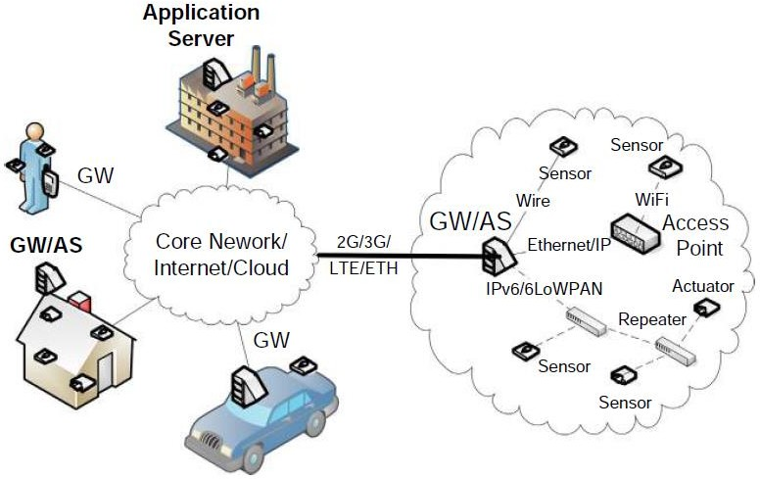
18CSE345T-INTERNET OF THINGS ARCHITECTURE AND PROTOCOLS
MTC refers to small amounts of data that are communicated between machines (devices to back-end services and vice versa) without the need for any human intervention.
In the 3rd Generation Partnership Project (3GPP), MTC is used to refer to all M2M communication. Thus, they are interchangeable terms.
Local area networking
Capillary networks and their inside view

Slide 31
18CSE345T-INTERNET OF THINGS ARCHITECTURE AND PROTOCOLS
Capillary networks are typically autonomous, self-contained systems of M2M devices that may be connected to the cloud via an appropriate Gateway.
They are often deployed in controlled environments such as vehicles, buildings, apartments, factories, bodies, etc. in order to collect sensor measurements, generate events should sensing thresholds be breached, and sometimes control specific features of interest (e.g. Heart rate of a patient, environmental data on a factory floor, car speed, air conditioning appliances, etc.).
There will exist numerous capillary networks that will employ short-range wired and wireless communication and networking technologies.
For certain application areas, there is a need for autonomous local operation of the capillary network. That is, not everything needs to be sent to, or potentially be controlled via, the cloud.
If application-level logic is enforceable via the cloud, some will still need to be managed locally.
The complexity of the local application logic varies by application. For example, a building automation network may need local control loop functionality for autonomous operation, but can rely on external communication for configuration of control schemas and parameters.
The M2M devices in a capillary network are typically thought to be low-capability nodes (e.g. battery operated, with limited security capabilities) for cost reasons, and should operate autonomously.
IPv6 will be the protocol of choice for M2M devices that operate a 6LoWPAN-based stack. IPv4 will still be used for capillary networks operating in non-6LoWPAN IP stacks (e.g. Wi-Fi capillary networks).

Slide 32
18CSE345T-INTERNET OF THINGS ARCHITECTURE AND PROTOCOLS
IoT Reference model:
In an IoT system, data is generated by multiple kinds of devices, processed in different ways, transmitted to different locations, and acted upon by applications. The proposed IoT reference model is comprised of seven levels. Each level is defined with terminology that can be standardized to create a globally accepted frame of reference. The IoT Reference Model does not restrict the scope or locality of its components. For example, from a physical perspective, every element could reside in a single rack of equipment or it could be distributed across the world. The IoT Reference Model also allows the processing occurring at each level to range from trivial to complex, depending on the situation. The model describes how tasks at each level should be handled to maintain simplicity, allow high scalability, and ensure supportability. Finally, the model defines the functions required for an IoT system to be complete. Figure illustrates the IoT Reference model and its levels. It is important to note that in the IoT, data flows in both directions. In a control pattern, control information flows from the top of the model (level 7) to the bottom (level 1). In a monitoring pattern, the flow of information is the reverse. In most systems, the flow will be bidirectional.

Slide 33
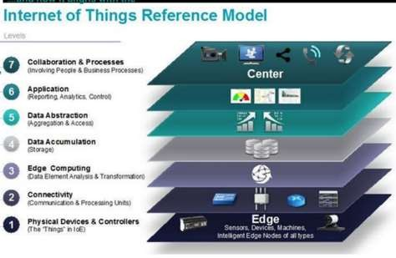
18CSE345T-INTERNET OF THINGS ARCHITECTURE AND PROTOCOLS

Slide 34
18CSE345T-INTERNET OF THINGS ARCHITECTURE AND PROTOCOLS
Level 1: Physical Devices and Controllers
The IoT Reference Model starts with Level 1: physical devices and controllers that might control multiple devices. These are the “things” in the IoT, and they include a wide range of endpoint devices that send and receive information. Today, the list of devices is already extensive. It will become almost unlimited as more equipment is added to the IoT over time. Devices are diverse, and there are no rules about size, location, form factor, or origin. Some devices will be the size of a silicon chip. Some will be as large as vehicles. The IoT must support the entire range. Dozens or hundreds of equipment manufacturers will produce IoT devices. To simplify compatibility and support manufacturability, the IoT Reference Model generally describes the level of processing needed from Level 1 devices.
Level 2: Connectivity
Communications and connectivity are concentrated in one level—Level 2. The most important function of Level 2 is reliable, timely information transmission. This includes transmissions:
● Between devices (Level 1) and the network
● Across networks (east-west)
● Between the network (Level 2) and low-level information processing occurring at Level 3
Traditional data communication networks have multiple functions, as evidenced by the International Organization for Standardization (ISO) 7-layer reference model. However, a complete IoT system contains many levels in addition to the communications network. One objective of the IoT Reference Model is for communications and processing to be executed by existing networks. The IoT Reference Model does not require or indicate creation of a different network—it relies on existing networks.

Slide 35
18CSE345T-INTERNET OF THINGS ARCHITECTURE AND PROTOCOLS
The IoT Reference Model does not require or indicate creation of a different network—it relies on existing networks. However, some legacy devices aren’t IP- enabled, which will require introducing communication gateways. Other devices will require proprietary controllers to serve the communication function. However, over time, standardization will increase. As Level 1 devices proliferate, the ways in which they interact with Level 2 connectivity equipment may change. Regardless of the details, Level 1 devices communicate through the IoT system by interacting with Level 2 connectivity equipment.
Level 3: Edge (Fog) Computing
The functions of Level 3 are driven by the need to convert network data flows into information that is suitable for storage and higher-level processing at Level 4 (data accumulation). This means that Level 3 activities focus on high-volume data analysis and transformation. For example, a Level 1 sensor device might generate data samples multiple times per second, 24 hours a day, 365 days a year. A basic tenet of the IoT Reference Model is that the most intelligent system initiates information processing as early and as close to the edge of the network as possible. This is sometimes referred to as fog computing. Level 3 is where this occurs. Given that data is usually submitted to the connectivity level (Level 2) networking equipment by devices in small units, Level 3 processing is performed on a packet-by-packet basis. This processing is limited, because there is only awareness of data units—not “sessions” or “transactions.” Level 3 processing can encompass many examples, such as:
Evaluation: Evaluating data for criteria as to whether it should be processed at a higher level
Formatting: Reformatting data for consistent higher-level processing

Slide 36
18CSE345T-INTERNET OF THINGS ARCHITECTURE AND PROTOCOLS
Expanding/decoding: Handling cryptic data with additional context (such as the origin)
Distillation/reduction: Reducing and/or summarizing data to minimize the impact of data and traffic on the network and higher-level processing systems
Assessment: Determining whether data represents a threshold or alert; this could include redirecting data to additional destinations
Level 4: Data Accumulation
Networking systems are built to reliably move data. The data is “in motion.” Prior to Level 4, data is moving through the network at the rate and organization determined by the devices generating the data. The model is event driven. As defined earlier, Level 1 devices do not include computing capabilities themselves. However, some computational activities could occur at Level 2, such as protocol translation or application of network security policy. Additional compute tasks can be performed at Level 3, such as packet inspection. Driving computational tasks as close to the edge of the IoT as possible, with heterogeneous systems distributed across multiple management domains represents an example of fog computing.
Fog computing and fog services will be a distinguishing characteristic of the IoT. Most applications cannot, or do not need to, process data at network wire speed. Applications typically assume that data is “at rest”—or unchanging—in memory or on disk. At Level 4, Data Accumulation, data in motion is converted to data at rest.

Slide 37
18CSE345T-INTERNET OF THINGS ARCHITECTURE AND PROTOCOLS
Level 5: Data Abstraction
IoT systems will need to scale to a corporate—or even global—level and will require multiple storage systems to accommodate IoT device data and data from traditional enterprise ERP, HRMS, CRM, and other systems. The data abstraction functions of Level 5 are focused on rendering data and its storage in ways that enable developing simpler, performance- enhanced applications.
With multiple devices generating data, there are many reasons why this data may not land in the same data storage:
There might be too much data to put in one place.
Moving data into a database might consume too much processing power, so that retrieving it must be separated from the data generation process. This is done today with online transaction processing (OLTP) databases and data warehouses.
Devices might be geographically separated, and processing is optimized locally.
Levels 3 and 4 might separate “continuous streams of raw data” from “data that represents an event.” Data storage for streaming data may be a big data system, such as Hadoop. Storage for event data may be a relational database management system (RDBMS) with faster query times.
Different kinds of data processing might be required.
For example, in-store processing will focus on different things than across-all-stores summary processing. For these reasons, the data abstraction level must process many different things. These include:
Reconciling multiple data formats from different sources
Assuring consistent semantics of data across sources

Slide 38
18CSE345T-INTERNET OF THINGS ARCHITECTURE AND PROTOCOLS
Confirming that data is complete to the higher-level application
Consolidating data into one place (with ETL, ELT, or data replication) or providing accessto multiple data stores through data virtualization
Protecting data with appropriate authentication and authorization
Normalizing or de normalizing and indexing data to provide fast application access Level.
Level 6- Application It is the application level, where information interpretation occurs. Software at this level interacts with Level 5 and data at rest, so it does not have to operate at network speeds. The IoT Reference Model does not strictly define an application. Applications vary based on vertical markets, the nature of device data, and business needs. For example, some applications will focus on monitoring device data. Some will focus on controlling devices. Some will combine device and non-device data. Monitoring and control applications represent many different application models, programming patterns, and software stacks, leading to discussions of operating systems, mobility, application servers, hypervisors, multi- threading, multi-tenancy, etc. These topics are beyond the scope of the IoT Reference Model discussion. Suffice it to say that application complexity will vary widely.
Examples include:
Mission-critical business applications, such as generalized ERP or specialized industry solutions
Mobile applications that handle simple interactions
Business intelligence reports, where the application is the BI server.
If Levels 1-5 are architected properly, the amount of work required by Level 6 will be reduced. If Level 6 is designed properly, users will be able to do their jobs better.

Slide 39
18CSE345T-INTERNET OF THINGS ARCHITECTURE AND PROTOCOLS
Level 7: Collaboration and Processes
One of the main distinctions between the Internet of Things (IoT) and IoT is that IoT includes people and processes. This difference becomes particularly clear at Level 7: Collaboration and Processes. The IoT system, and the information it creates, is of little value unless it yield saction, which often requires people and processes. Applications execute business logic to empower people. People use applications and associated data for their specific needs. Often, multiple people use the same application for a range of different purposes. So, the objective is not the application—it is to empower people to do their work better. Applications (Level 6) give business people the right data, at the right time, so they can do the right thing. But frequently, the action needed requires more than one person. People must be able to communicate and collaborate, sometimes using the traditional Internet, to make the IoT useful. Communication and collaboration often require multiple steps. And it usually transcends multiple applications. This is why Level 7, represents a higher level than a single application.

Slide 40
18CSE345T-INTERNET OF THINGS ARCHITECTURE AND PROTOCOLS
IoT Domain model
An example of mapping an IoT Domain Model and Functional View to Devices with different capabilities (different alternatives) connecting to a cloud infrastructure. Alternative 1 shows device that can host only a simple Sensor Device and a short-range wired or wireless connectivity technology (Basic Device #1).
Such kind of device needs an Advanced Device of type #1 that allows the basic device to perform protocol adaptation (at least from the short-range wired or wireless connectivity technology to a WAN technology) so that the Sensor IoT service in the cloud and the Sensor Resource on the Basic Device #1 can exchange information.
The Virtual Entity representing the Physical Entity where the Basic Device #1 is deployed is also hosted in the cloud.
In alternative 2, Advanced Devices (type #2) can host the Sensor IoT Service communicating to the Sensor Resource on a Basic Device #1.
The cloud infrastructure in this case only hosts the Virtual Entity Service corresponding to the Sensor IoT Service. The difference between alternative 1 and 2 is that the Sensor IoT Service hosted on an Advanced Device #2 should be capable of responding to requests from Users (cloud services, Applications) with the
appropriate secure mediation of course.
In alternative 3, the Basic Device #3 is capable of providing the Sensor Resource and the Sensor IoT Service but still needs an Advanced Device #1 to transport IoT service requests/responses/subscriptions/
notifications/publications to the Users in the cloud. According to experience, this kind of deployment scenario imposes a high burden on a Basic Device, which potentially makes the Basic Device the weakest link in the information flow

Slide 41
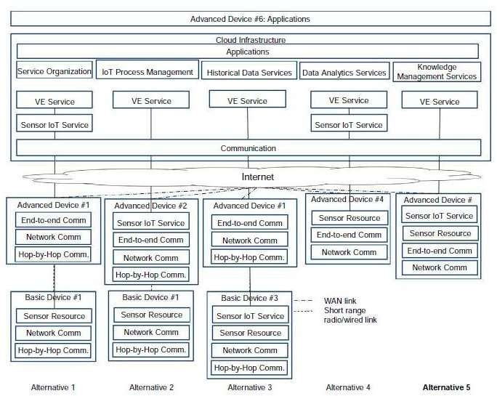
18CSE345T-INTERNET OF THINGS ARCHITECTURE AND PROTOCOLS
If malicious Users launch a Denial of Service (DoS) attack on the node, the probability of the node going down is very high.
Alternatives 4 and 5 show Advanced Devices offering a WAN interface.In alternative 4, only the Sensor Resource is hosted on the Device, while in alternative 5, even the IoT Service is hosted on the Device. The Virtual Entity Service is hosted in the cloud.

Slide 42
18CSE345T-INTERNET OF THINGS ARCHITECTURE AND PROTOCOLS
Information model:
The information view consists of (a) the description of the information handled in the IoT System, and (b) the way this information is handled in the system; in other words, the information lifecycle and flow (how information is created, processed, and deleted), and the information handling components.
Information description
The pieces of information handled by an IoT system complying to an ARM such as the IoT-A are the following:
Virtual Entity context information, i.e. the attributes (simple or complex) as represented by parts of the IoT Information model (attributes that have values and metadata such as the temperature of a room).
This is one
of the most important pieces of information that should be captured by an IoT system, and represents the properties of the associated Physical Entities or Things.
IoT Service output itself is another important part of information generated by an IoT system. For example, this is the information generated by interrogating a Sensor or a Tag Service.
Virtual Entity descriptions in general, which contain not only the attributes coming from IoT Devices (e.g. ownership information).

Slide 43
18CSE345T-INTERNET OF THINGS ARCHITECTURE AND PROTOCOLS
Associations between Virtual Entities and related IoT Services.
Virtual Entity Associations with other Virtual Entities (e.g. Room #123 is on Floor #7).
IoT Service Descriptions, which contain associated Resources, interface descriptions, etc.
Resource Descriptions, which contain the type of resource (e.g. sensor), identity, associated Services, and Devices.
Device Descriptions such as device capabilities (e.g. sensors, radios).
Descriptions of Composed Services, which contain the model of how a complex service is composed of simpler services.
IoT Business Process Model, which describes the steps of a business process utilizing other IoT-related services (IoT, Virtual Entity, Composed Services).
Security information such as keys, identity pools, policies, trust models, reputation scores, etc.
Management information such as state information from operational FCs used for fault/performance purposes, configuration snapshots, reports, membership information, etc.

Slide 44
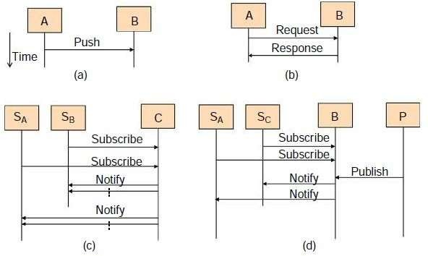
18CSE345T-INTERNET OF THINGS ARCHITECTURE AND PROTOCOLS
Information exchange patterns.
Push: An FC A pushes the information to another FC B provided that the contact information of the component B is already configured in component A, and component B listens for such information pushes.

Slide 45
18CSE345T-INTERNET OF THINGS ARCHITECTURE AND PROTOCOLS
Request/Response: An FC A sends a request to another FC B and receives a response from B after A serves the request. Typically, the interaction is synchronous in the sense that A must wait for a response from B before proceeding to other tasks, but in practice this limitation can be realized with parts of component A waiting, and other parts performing other tasks. Component B may need to handle concurrent requests and responses from multiple components, which imposes certain requirements on the capabilities for the device or the network that hosts the FC.
Subscribe/Notify: Multiple subscriber components (SA, SB) can subscribe for information to a component C, and C will notify the relevant subscribers when the requested information is ready. This is typically an asynchronous information request after which each subscriber can perform other tasks. Nevertheless, a subscriber needs to have some listening components for receiving the asynchronous response. The target component C also needs to maintain state information about which subscribers requested which information and their contact information.
The Subscribe/Notify pattern is applicable when typically, one component is the host of the information needed by multiple other components. Then the subscribers need only establish a Subscribe/Notify relationship with one component. If multiple components can be information producers or information hosts, the Publish/Subscribe pattern is a more scalable solution from the point of view of the subscribers.
Publish/Subscribe: In the Publish/Subscribe (also known as a Pub/Sub pattern), there is a third component called the broker B, which mediates subscription and publications between subscribers (information consumers) and publishers (or information producers). Subscribers such as SA and SB subscribe to the broker about the information, they are interested in by describing the different properties of the information. Publishers publish information and metadata to the broker, and the broker pushes the published information to (notification) the subscribers whose interests match the published information.

Slide 46
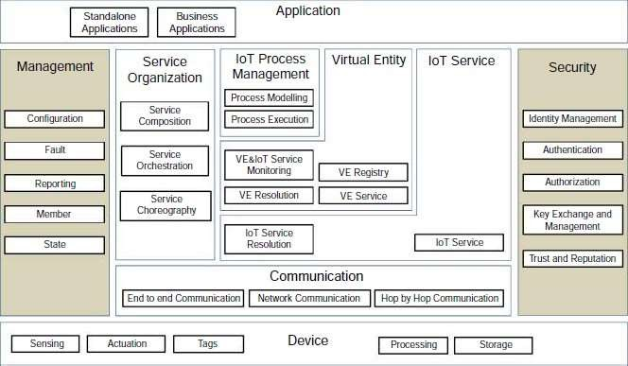
18CSE345T-INTERNET OF THINGS ARCHITECTURE AND PROTOCOLS
Functional model:
The functional view for the IoT Reference Architecture is presented in Fig ,and is adapted from IoT- A .
It consists of the Functional Groups (FGs) presented earlier in the IoT Functional Model, each of which includes a set of Functional Components (FCs).
It is important to note that not all the FCs are used in a concrete IoT architecture, and therefore the actual system as explained earlier

Slide 47
18CSE345T-INTERNET OF THINGS ARCHITECTURE AND PROTOCOLS
Device and Application functional group
The Device and Application FGs are already covered in the IoT Functional Model. For convenience the Device FG contains the Sensing, Actuation, Tag, Processing, Storage FCs, or simply components.
These components represent the resources of the device attached to the Physical Entities of interest. The Application FG contains either standalone applications (e.g. for iOS, Android, Windows phone), or Business Applications that connect the IoT system to an Enterprise system.
COMMUNICATION MODEL:
The communication layer supports the connectivity of the devices. There are multiple potential protocols for communication between the devices and the cloud.
The most well-known three potential protocols are
HTTP/HTTPS (and RESTful approaches on those)
MQTT 3.1/3.1.1(Message Queuing Telemetry Transport)
Constrained application protocol (CoAP)
HTTP is well known, and there are many libraries that support it. Because it is a simple text- based protocol, many small devices such as 8-bit controllers can only partially support the protocol – for example enough code to POST or GET a resource. The larger 32-bit based devices can utilize full HTTP client libraries that properly implement the whole protocol.

Slide 48
18CSE345T-INTERNET OF THINGS ARCHITECTURE AND PROTOCOLS
There are several protocols optimized for IoT use. The two best known are MQTT6 and CoAP7. MQTT was invented in 1999 to solve issues in embedded systems and SCADA. It has been through some iterations and the current version (3.1.1) is undergoing standardization in the OASIS MQTT Technical Committee8. MQTT is a publish-subscribe messaging system based on a broker model. The protocol has a very small overhead (as little as 2 bytes per message), and was designed to support lossy and intermittently connected networks. MQTT was designed to flow over TCP. In addition, there is an associated specification designed for ZigBee-style networks called MQTT-SN (Sensor Networks). CoAP is a protocol from the IETF that is designed to provide a RESTful application protocol modeled on HTTP semantics, but with a much smaller footprint and a binary rather than a text- based approach. CoAP is a more traditional client-server approach rather than a brokered approach. CoAP is designed to be used over UDP. For the reference architecture we have opted to select MQTT as the preferred device communication protocol, with HTTP as an alternative option.
The reasons to select MQTT and not CoAP at this stage are
Better adoption and wider library support for MQTT;
Simplified bridging into existing event collection and event processing systems; and
Simpler connectivity over firewalls and NAT networks
However, both protocols have specific strengths (and weaknesses) and so there will be some situations where CoAP may be preferable and could be swapped in. In order to support MQTT we need to have an MQTT broker in the architecture as well as device libraries. We will discuss this with regard to security and scalability later.

Slide 49
18CSE345T-INTERNET OF THINGS ARCHITECTURE AND PROTOCOLS
One important aspect with IoT devices is not just for the device to send data to the cloud/ server, but also the reverse. This is one of the benefits of the MQTT specification: because it is a brokered model, clients connect an outbound connection to the broker, whether or not the device is acting as a publisher or subscriber. This usually avoids firewall problems because this approach works even behind firewalls or via NAT. In the case where the main communication is based on HTTP, the traditional approach for sending data to the device would be to use HTTP Polling. This is very inefficient and costly, both in terms of network traffic as well as power requirements. The modern replacement for this is the WebSocket protocol9 that allows an HTTP connection to be upgraded into a full two-way connection. This then acts as a socket channel (similar to a pure TCP channel) between the server and client.
Safety, privacy, trust, security model-
Security in IOT :- IOT security refers to the methods of protection used to secure internet-connected or network-based devices. The term IoT is incredibly broad, and with the technology continuing to evolve, the term has only become broader. From watches to thermostats to video game consoles, nearly every technological device has the ability to interact with the internet, or other devices, in some capacity.
Few of the IoT security challenges that continue to threaten the financial safety of both individuals and organizations :-
Remote exposure
Lack of industry foresight
Resource constraints

Slide 50
18CSE345T-INTERNET OF THINGS ARCHITECTURE AND PROTOCOLS
Privacy in the Internet of Things is the threefold guarantee to the subject for -
awareness of privacy risks imposed by smart things and services surrounding the data subject
individual control over the collection and processing of personal information by the surrounding smart things
awareness and control of subsequent use and dissemination of personal information by those entities to any entity outside the subject’s personal control sphere
Authentication in IOT :- Authentication is the process of identifying the device. For Message Queuing Telemetry Transport (MQTT), the process of authentication is to confirm that the device’s client ID is valid; that is, the ID belongs to the device in question.
The ability to secure data and limit it to only those with the correct permissions is not a new idea and is used extensively in many industries. One can only wonder why connected devices were not subject to the same security principles from the beginning.
There are simply too many categories of IoT devices to mention in a post of this size but they vary widely in terms of security levels. Some connect using proximity-based protocols such as Bluetooth, RFID (radio frequency identification), or Wi-Fi while others use GPS, 4G or are hard-wired. Connecting them is often as easy as scanning for nearby devices, by inputting a short code (that may or may not be changed from a default) or by using a form of multi-factor authentication to verify device and recipient permissions.

Slide 51
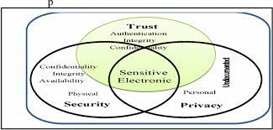
18CSE345T-INTERNET OF THINGS ARCHITECTURE AND PROTOCOLS
Trust in IOT :- The word “trust” in this context means reliance. A trust model shows how each entity in an ecosystem relies (or could rely) on another. And human-centric in this context means a trust model aimed at giving effective administration of security, not to computing professionals, but to average users.
Various components of such a model :-
Devices and Hosted Applications
Resources,
Trusted Attributes
Delegating Trust
Virtual Composite Devices

Slide 52

18CSE345T-INTERNET OF THINGS ARCHITECTURE AND PROTOCOLS
Introduction to Protocols- Physical, Data Link-
Physical Layer
The lowest layer of the OSI reference model is the physical layer. It is responsible for the actual physical connection between the devices. The physical layer contains information in the form of bits. It is responsible for transmitting individual bits from one node to the next. When receiving data, this layer will get the signal received and convert it into 0s and 1s and send them to the Data Link layer, which will put the frame back together.
.
The Functions of the Physical Layer
Bit synchronization: The physical layer provides the synchronization of the bits by providing a clock. This clock controls both sender and receiver thus providing synchronization at the bit level.
Bit rate control: The Physical layer also defines the transmission rate i.e. the number of bits sent per second.
Physical topologies: Physical layer specifies how the different, devices/nodes are arranged in a network i.e. bus, star, or mesh topology.
Transmission mode: Physical layer also defines how the data flows between the two connected devices. The various transmission modes possible are Simplex, half-duplex and full-duplex.
Note: 1. Hub, Repeater, Modem, and Cables are Physical Layer devices.

Slide 53
18CSE345T-INTERNET OF THINGS ARCHITECTURE AND PROTOCOLS
Introduction to Protocols- Physical, Data Link
DATA LINK
The Data-link layer is the second layer from the bottom in the OSI (Open System Interconnection) network architecture model. It is responsible for the node-to-node delivery of data. Its major role is to ensure error-free transmission of information. DLL is also responsible to encode, decode and organize the outgoing and incoming data. This is considered the most complex layer of the OSI model as it hides all the underlying complexities of the hardware from the other above layers.
Sub-layers of Data Link Layer:
The data link layer is further divided into two sub-layers, which are as follows:
Logical Link Control (LLC):
This sublayer of the data link layer deals with multiplexing, the flow of data among applications and other services, and LLC is responsible for providing error messages and acknowledgments as well.
Media Access Control (MAC):
MAC sublayer manages the device’s interaction, responsible for addressing frames, and also controls physical media access. The data link layer receives the information in the form of packets from the Network layer, it divides packets into frames and sends those frames bit-by-bit to the underlying physical layer.

Slide 54
18CSE345T-INTERNET OF THINGS ARCHITECTURE AND PROTOCOLS
Introduction to Protocols- Network, Transport, Application
Network Layer
The network layer works for the transmission of data from one host to the other located in different networks. It also takes care of packet routing i.e. selection of the shortest path to transmit the packet, from the number of routes available. The sender & receiver’s IP addresses are placed in the header by the network layer.
The Functions of the Network Layer
Routing: The network layer protocols determine which route is suitable from source to destination. This function of the network layer is known as routing.
Logical Addressing: To identify each device on Internetwork uniquely, the network layer defines an addressing scheme. The sender & receiver’s IP addresses are placed in the header by the network layer. Such an address distinguishes each device uniquely and universally.
Note: 1. Segment in the Network layer is referred to as Packet.
2. Network layer is implemented by networking devices such as routers.
Transport Layer
The transport layer is represented by two protocols: TCP and UDP.
The IP protocol in the network layer delivers a datagram from a source host to the destination host.
Nowadays, the operating system supports multiuser and multiprocessing environments, an executing program is called a process. When a host sends a message to other host means that source process is sending a process to a destination process. The transport layer protocols define some connections to individual ports known as protocol ports.

Slide 55
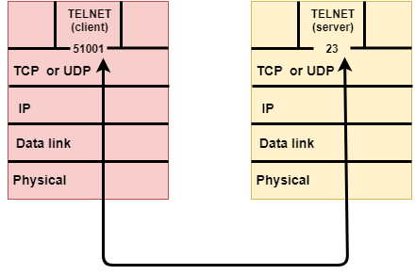
18CSE345T-INTERNET OF THINGS ARCHITECTURE AND PROTOCOLS
An IP protocol is a host-to-host protocol used to deliver a packet from source host to the destination host while transport layer protocols are port-to-port protocols that work on the top of the IP protocols to deliver the packet from the originating port to the IP services, and from IP services to the destination port.
Each port is defined by a positive integer address, and it is of 16 bits.

Slide 56
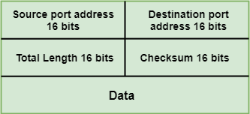
18CSE345T-INTERNET OF THINGS ARCHITECTURE AND PROTOCOLS
UDP
UDP stands for User Datagram Protocol.
UDP is a simple protocol and it provides nonsequenced transport functionality.
UDP is a connectionless protocol.
This type of protocol is used when reliability and security are less important than speed and size.
UDP is an end-to-end transport level protocol that adds transport-level addresses, checksum error control, and length information to the data from the upper layer.
The packet produced by the UDP protocol is known as a user datagram.
User Datagram Format
The user datagram has a 16-byte header which is shown below:

Slide 57
18CSE345T-INTERNET OF THINGS ARCHITECTURE AND PROTOCOLS
Source port address: It defines the address of the application process that has delivered a message. The source port address is of 16 bits address.
Destination port address: It defines the address of the application process that will receive the message. The destination port address is of a 16-bit address.
Total length: It defines the total length of the user datagram in bytes. It is a 16-bit field.
Checksum: The checksum is a 16-bit field which is used in error detection.
Disadvantages of UDP protocol
UDP provides basic functions needed for the end-to-end delivery of a transmission.
It does not provide any sequencing or reordering functions and does not specify the damaged packet when reporting an error.
UDP can discover that an error has occurred, but it does not specify which packet has been lost as it does not contain an ID or sequencing number of a particular data segment.

Slide 58
18CSE345T-INTERNET OF THINGS ARCHITECTURE AND PROTOCOLS
TCP
TCP stands for Transmission Control Protocol.
It provides full transport layer services to applications.
It is a connection-oriented protocol means the connection established between both the ends of the transmission. For creating the connection, TCP generates a virtual circuit between sender and receiver for the duration of a transmission.
Application Layer
At the very top of the OSI Reference Model stack of layers, we find the Application layer which is implemented by the network applications. These applications produce the data, which has to be transferred over the network. This layer also serves as a window for the application services to access the network and for displaying the received information to the user.
Example: Application – Browsers, Skype Messenger, etc.
Note: The application Layer is also called Desktop Layer.
The Functions of the Application Layer are
Network Virtual Terminal
FTAM- File transfer access and management
Mail Services
Directory Services

